Slide 1

ENGINEERING CHEMISTRY
Lata Pasupulety
Department of Science and Humanities

Slide 2

ENGINEERING CHEMISTRY
Module 4 – Electrochemical Equilibria
Class content:
Numericals on electrochemistry
Nernst equation
Ion selective electrode

Slide 3


ENGINEERING CHEMISTRY
Module 4 – Electrochemical Equilibria
For the given cell:
Fe/Fe ²⁺ (0.05M)//Ag⁺ (0.1M)/Ag
(i) Write the overall cell reaction
(ii) Calculate E⁰_{cell} and E _{cell} at 25⁰C
(Given : E⁰_{Fe+2/} _{Fe}= - 0.44V ; E⁰_{Ag+/Ag} = 0.80V)
Sol.
Anode : Fe → Fe²⁺ + 2e⁻
Cathode : 2Ag⁺ + 2e⁻ → 2Ag
Overall reaction : Fe + 2Ag⁺ → Fe²⁺ + 2Ag
E⁰_{cell}= Eº_{C}-Eº_{A} = 0.80 + 0.44 =1.24V
$Ecell=1.24− \frac{0.0591}{2}\log{(\frac{[0.05]}{{[0.1]}^{2}}}$)
E_{cell} =1.2193V

Slide 4
ENGINEERING CHEMISTRY
Module 4 – Electrochemical Equilibria
2. For the following concentration cell:
Pt/H₂ (8atm)/HCl(0.3M)/H₂(2atm)/Pt
Calculate potential of the cell at 25⁰C.
Sol.
E_{cell} = 0.01779V

Slide 5
ENGINEERING CHEMISTRY
Module 4 – Electrochemical Equilibria
3. A decinormal calomel electrode as cathode is coupled with a saturated calomel electrode as anode to form a cell. Write the cell representation and calculate the concentration of Cl⁻ ion in the saturated calomel electrode, if the cell potential measured is 0.0988 V at 25⁰C.
Sol.
Pt/Hg/Hg₂Cl₂/Cl⁻(x)//Cl⁻(0.1M)/Hg₂Cl₂/Hg/Pt
E_{cell} = E_{R}-E_{L}
= [E⁰ - 0.0591log (0.1)] –[ E⁰ - 0.0591log(x)]
1.6717 - 1= log(x)
x = Antilog(0.6717)
x = 4.69M

Slide 6

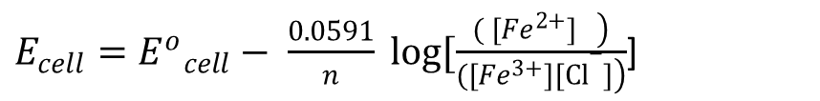
ENGINEERING CHEMISTRY
Module 4 – Electrochemical Equilibria
4. For the following cell: Ag/AgCl/Cl⁻(0.1M)// Fe²⁺ (0.29M), Fe³⁺ (0.18M)/Pt Write the half cell reactions and overall cell reaction. Calculate Eº_{Cell} and E_{Cell} at 298 K (Given:E⁰_{Fe}³⁺/_{Fe}²⁺=0.77 V , E⁰_{Calomel}=0.222 V, R = 8.314 J/K/mol, F =96500 C/mol)
Sol.
(i) Anode: Ag + Cl⁻ → AgCl + e⁻
Cathode : Fe³⁺ + e⁻ → Fe²⁺
Overall : Ag + Cl⁻ + Fe³⁺→ AgCl + Fe²⁺
(ii) E⁰_{cell} = Eº_{C}-Eº_{A} = 0.77-0.222 = 0.548V
$E_{cell}={E^{o}}_{cell}− \frac{0.0591}{n} log[\frac{\left.{( [Fe}^{2+}] \right)}{\left.{([Fe}^{3+}][Cl−]\right)}$]
E_{Cell=} 0.4767V

Slide 7

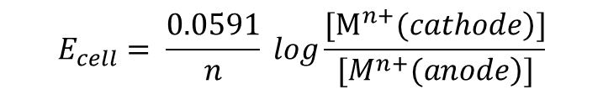
ENGINEERING CHEMISTRY
Module 4 – Electrochemical Equilibria
5. Calculate the EMF of the following cell at 25⁰C. Au/Au³⁺ (0.05M) // Au³⁺ (0.12 M)/ Au (Given : R = 8.314 J/K/mol, F = 96500 C/mol)
Sol.
$$E_{cell}= \frac{0.0591}{n} log\frac{[\left.M^{n+}(cathode\right)]}{[\left.M^{n+}(anode\right)]}$$
n = 3 ,
E_{cell} = 0.00749V

Slide 8
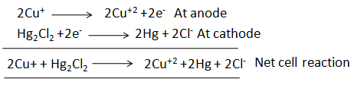

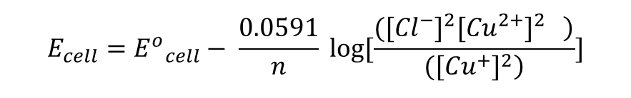
ENGINEERING CHEMISTRY
Module 4 – Electrochemical Equilibria
6. A decinormal calomel electrode is used to determine the potential of the following redox electrode : Pt/Cu²⁺(0.58 M),Cu⁺(0.08M)
(i) Write cell representation.
(ii) Write the reactions at the electrodes
(iii) Calculate E⁰_{cell} and E_{cell} at 298 K.
(Given : Eº_{Hg/Hg2Cl2/Cl-} = 0.281V , E _{Cu2+/Cu} = 0.153 V)
Sol.
(i) Pt/Cu²⁺(0.58 M),Cu⁺(0.08M)//Cl⁻(0.1 M)/Hg₂Cl₂/Hg
(ii)
(iii) E⁰_{cell} = Eº_{C}-Eº_{A} = 0.281 -0.153 = 0.128 V
$$E_{cell}={E^{o}}_{cell}− \frac{0.0591}{n} log[\frac{\left.{{([Cl}^{−}]}^{2}{{[Cu}^{2+}]}^{2} \right)}{(\left.{{[Cu}^{+}]}^{2}\right)}]$$
E_{cell} = 0.1362 V

Slide 9
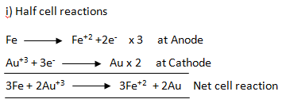


ENGINEERING CHEMISTRY
Module 4 – Electrochemical Equilibria
7. For the following cell:
Fe/Fe⁺²(0.1M)|| Au⁺³( 0.5M) /Au
Write the half cell reactions.
Calculate E⁰_{cell} and E_{cell} at 298K .
(Given E⁰ _{Au+3/Au} =1.52V, E⁰ _{Fe+2/Fe} = -0.44V, R = 8.314 J/K/mol, F = 96500C/mol)
Sol.
(ii) E⁰_{cell} = Eº_{C}-Eº_{A} = 1.52 +0.44 = 1.96 V
E_{cell}$=1.96 − \frac{0.0591}{6}$ log[ $\frac{\left[0.1\right]3}{\left[0.5\right]2}$]
E_{cell} = 1.9836 V

Slide 10


ENGINEERING CHEMISTRY
Module 4 – Electrochemical Equilibria
8. A glass electrode is coupled with saturated calomel electrode to measure unknown pH. The cell potentials measured are 0.215V and 0.385V in contact with a solution of pH = 7 and with solution of unknown pH respectively. Calculate the pH of unknown solution.
Given E_{SCE}=0.244V
Sol.
Eº_{G} = E_{cell} + 0.0591pH + E_{SCE}
= 0.215 + 0.0591 X 7 + 0.244
= 0.8727 V
pH = 4.12

Slide 11
THANK YOU
Lata Pasupulety
Department of Science and Humanities
latapasupulety@pes.edu
+91 80 6666 3333 Extn 759

